Slide 1
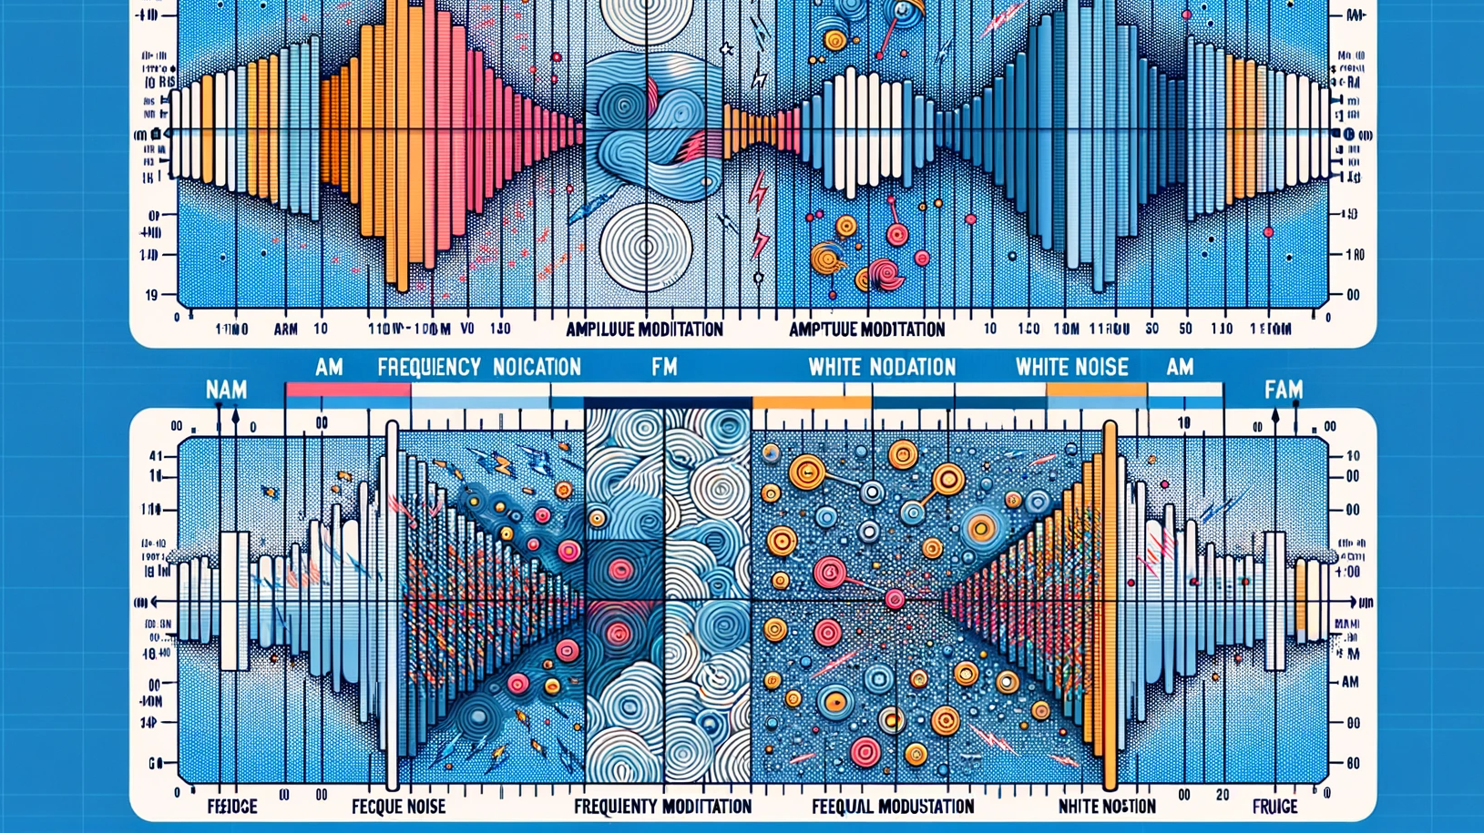

ECE459 Final Project: AM & FM Signal Transmission Under White Noise Condition
Group 6 Jie Wang, Suhao Wang, Junjie Ren, Junhao Zhu, Ruiqi Zhao
Presentation Date: Jan. 11, 2024; Supervised by Prof. Said Mikki & TA. Xuyang Bai

Slide 2

Outline
System Overview
White noise simulation & Average power computation
AM system demonstration(Jupyter Notebook)
FM system demonstration(Jupyter Notebook)
Discussion, Bug log, Our discovery
Bonus: Audio Signal Transmission Simulation
Bonus: Image Signal Transmission Simulation
Conclusion
Reference & Appendix

Slide 3
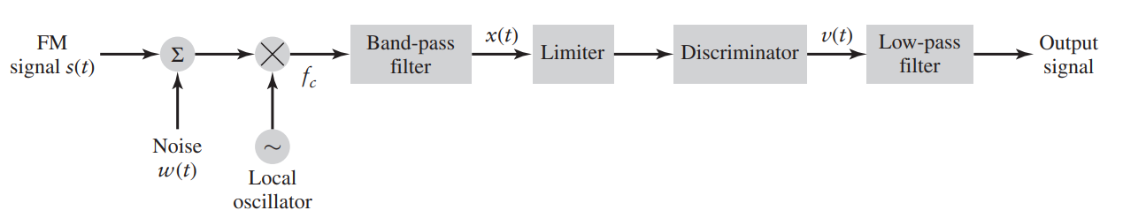
System Overview
recv(t)
Lim(t)
out (t)
demodulator

Slide 4
White noise simulation & Average power computation

Slide 5
System Overview
recv(t)
Lim(t)
out (t)
demodulator

Slide 6
Appendix A: Task Separation
Task 1: AM Setup: By Jie Wang 3200112404 1. AM modulation and demodulation with AWGN
2. Slide and Main Presentation
Task 2: AM SNR: By Junjie Ren 1. compare pre-detection and post-detecion SNR of AM signal
Task 3: FM Setup: By Junhao Zhu 1. FM modulation and demodulation with AWGN
Task 4: FM SNR: By RuiQi Zhao 1. compare pre-detection and post-detecion SNR of AM signal
Task 5: others: By Suhao Wang 1. introduction, applications, summary 2. FM modulation and demodulation
3. Bonus part of audio and image processing

Slide 7
Reference

Slide 8
The End
Thank you for listening!
ECE459 Final Project: AM & FM Signal Transmission Under White Noise Condition
Presentation Date: Jan. 11, 2024; Supervised by Prof. Said Mikki & TA. Xuyang Bai

